Slide 1

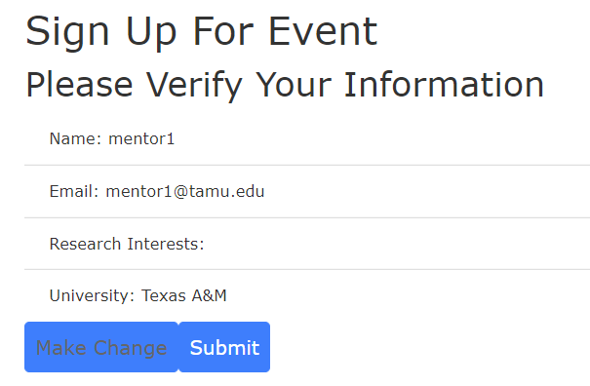

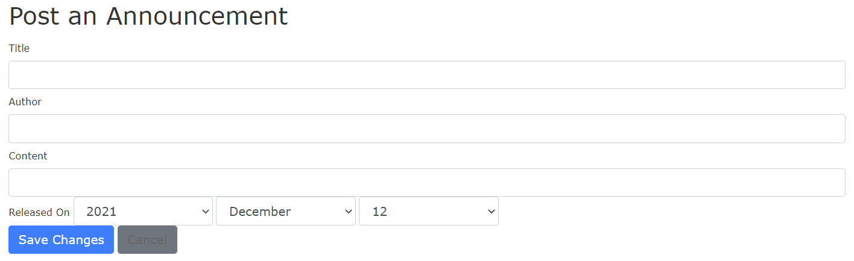
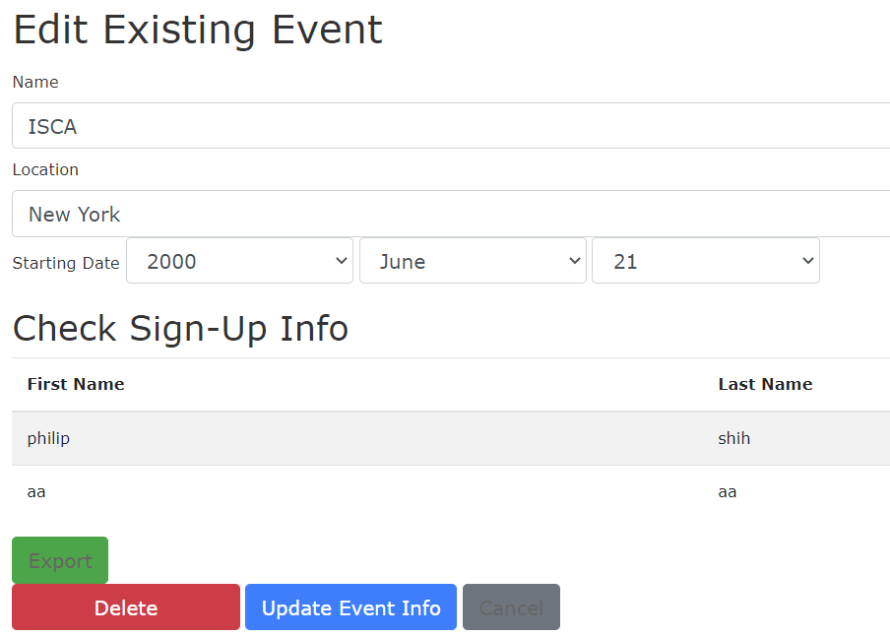

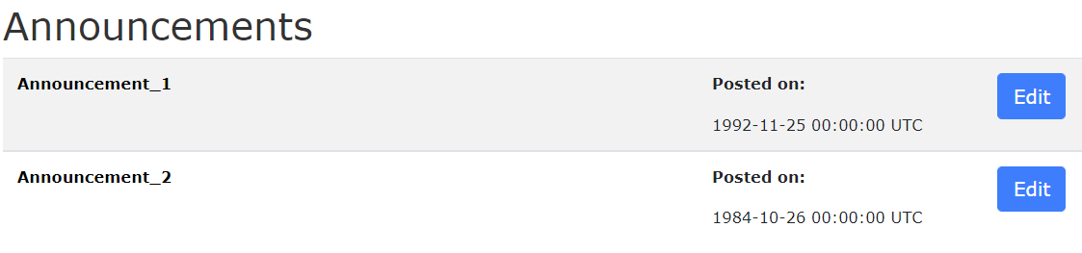
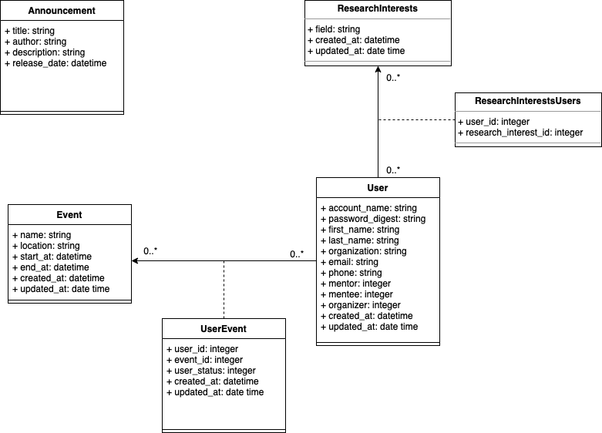
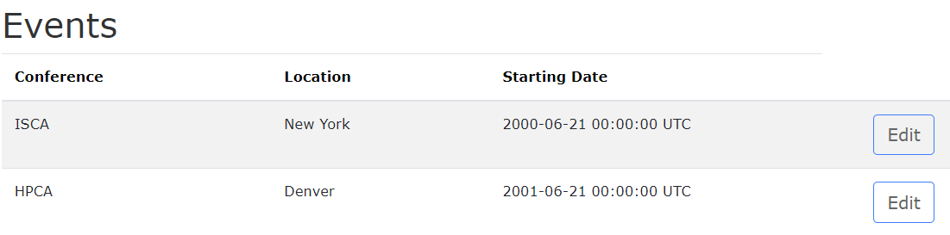
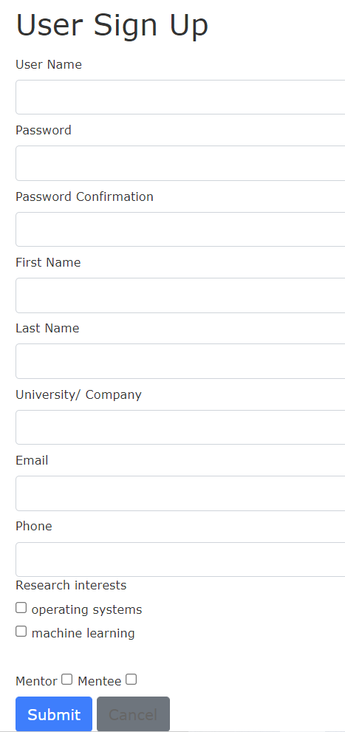
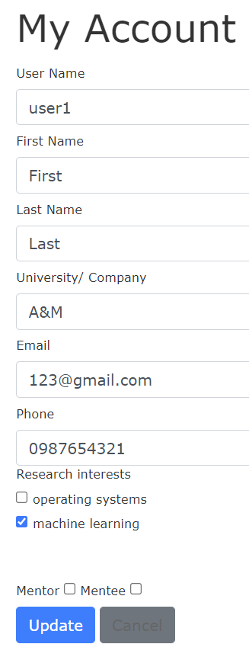
Computer Architecture Student Association Mentorship Website
Elba Garza, Chen Chuan Chang, Charles Chou, Johnson Hung, Philip Shih, Peter Wu, Ruiyu Qu
Dept. of Computer Science and Engineering, Texas A&M University
MissRevsDevs
Introduction
Event Signup Page
The Computer Architecture Student Association(CASA) hopes to have a website for their mentorship programs.
Tracking events and mentor/mentee matches are critical.
Idea: create a website where mentors can post announcements, setup events, and matches mentors and mentees; mentees can signup for events.
Event join button for users on home page.
Users can verify their information and signup for events in this page.
Website Workflow
Organizer:
Add/Edit Announcements and Events
Homepage(Before Login)
Log out
Homepage(After Login)
Add Announcement
Interface for posting announcement and editing announcement.
Login
Add Event
Edit Announcement
Sign Up Page
Login Page
My Account
Edit Event
Users:
Homepage(Before Login)
Log out
Homepage(After Login)
Event Signup
Login Page
Login
Login Page
Sign Up Page
Login Page
My Account
Sign Up Page
Sign Up Page
Homepage
There are “Login” and “Signup” buttons on top right of homepage.
In the middle, there are “Announcements” and “Events” sections.
Design Diagram
Sign up Page
Sign up Page
My Account Page
My Account Page
Testing
Interface for user sign up.
Interface for account info edit.
Tested website functions with scenarios using BDD/TDD.
Verified all the buttons and links were able to redirect correctly.
Conclusion
Our website for CASA is easy to use, has clean interface and fast response time.
It allows organizers to create, and edit both the announcements and events; users to register as mentor/mentee and sign up for events.
We finished original user stories and more.
Future work
Being able to insert pictures in announcements/events.
Develop algorithms to match mentors to mentees efficiently.
Display content from social media platforms.

